Slide 1
Lecture 12

Slide 2
Properties of Random Numbers
Randomness
Uniformity
distribution of bits in the sequence should be uniform
Independence
no one subsequence in the sequence can be inferred from the others
Unpredictable
satisfies the "next-bit test“

Slide 3
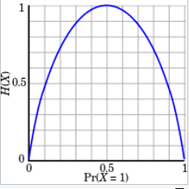

Entropy
A measure of uncertainty
In other words, a measure of how unpredictable the outcomes are
High entropy = unpredictable outcomes = desirable in cryptography
The uniform distribution has the highest entropy (every outcome equally likely, e.g. fair coin toss)
Usually measured in bits (so 3 bits of entropy = uniform, random distribution over 8 values)
Entropy of an information source

Slide 4
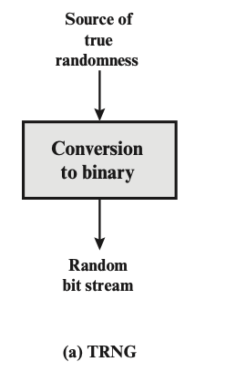
True random numbers generators
Several sources of randomness – natural sources of randomness
decay times of radioactive materials
electrical noise from a resistor or semiconductor
radio channel or audible noise
keyboard timings
disk electrical activity
mouse movements
Physical unclonable function (PUF)
Some are better than others

Slide 5
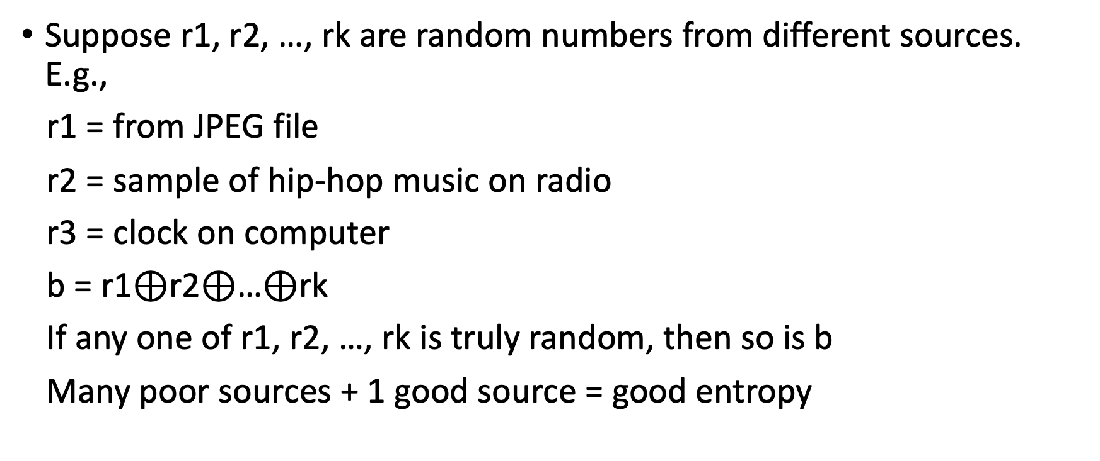
Combining sources of randomness
Suppose r1, r2, …, rk are random numbers from different sources. E.g.,
r1 = from JPEG file
r2 = sample of hip-hop music on radio
r3 = clock on computer
b = r1$⊕$r2$⊕$…$⊕$rk
If any one of r1, r2, …, rk is truly random, then so is b
Many poor sources + 1 good source = good entropy

Slide 6
Pseudorandom Number Generators (PRNGs)
True randomness is expensive
Pseudorandom number generator (PRNGs): An algorithm that uses a little bit of true randomness to generate a lot of random-looking output
Also called deterministic random bit generators (DRBGs)
PRNGs are deterministic: Output is generated according to a set algorithm
However, for an attacker who can’t see the internal state, the output is computationally indistinguishable from true randomness

Slide 7
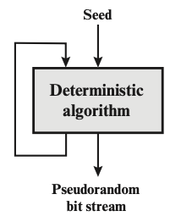
PRNG: Definition
A PRNG has two functions:
PRNG.Seed(randomness): Initializes the internal state using the entropy
Input: Some truly random bits
PRNG.Generate(n): Generate n pseudorandom bits
Input: A number n
Output: n pseudorandom bits
Updates the internal state as needed
Properties
Correctness: Deterministic
Efficiency: Efficient to generate pseudorandom bits
Security: Indistinguishability from random
Rollback resistance: cannot deduce anything about any previously-generated bit

Slide 8
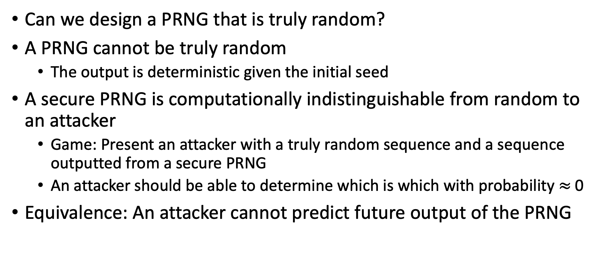
PRNG: Security
Can we design a PRNG that is truly random?
A PRNG cannot be truly random
The output is deterministic given the initial seed
A secure PRNG is computationally indistinguishable from random to an attacker
Game: Present an attacker with a truly random sequence and a sequence outputted from a secure PRNG
An attacker should be able to determine which is which with probability $≈$ 0
Equivalence: An attacker cannot predict future output of the PRNG

Slide 9
Insecure PRNGs: Breaking Slot Machines
What happens if PRNGs are used improperly?
Ex: Breaking slot machine
A casino in St. Louis experienced unusual bad “luck”
Suspicious players would hover over the lever and then spin at a specific time to win
Vulnerability: Slot machines used predictable PRNGs
The PRNG output was based on the current time
Strategy:
Use a smartphone to alert you to when to pull the lever for the best chance of winning
Las Vegas was not affected by the vulnerability
Nevada slot machines must follow evaluation standards designed to address this sort of issue

Slide 10
Create pseudorandom numbers
Truly random numbers are impossible with any program!
However, we can generate seemingly random numbers, called pseudorandom numbers
The function rand() returns a non-negative number between 0 and RAND_MAX
For C, it is defined in stdlib.h

Slide 11
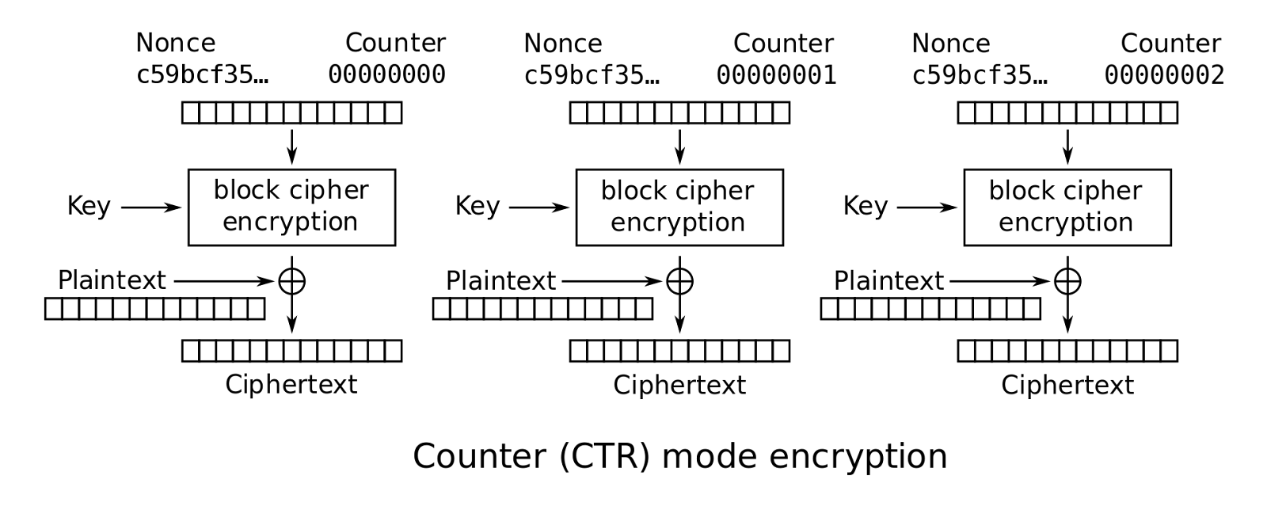
Example construction of PRNG
Using block cipher in Counter (CTR) mode:
If you want m random bits, and a block cipher with E_{k} has n bits, apply the block cipher m/n times and concatenate the result:
PRNG.Seed(K | IV) = E_{k}(IV, 1) | E_{k}(IV, 2) | E_{k}(IV, 3) … E_{k}(IV, ceil(m/n)),
| is concatenation
Initialization vector (IV) – typically is random or pseudorandom
Randomness,
PRNG output

Slide 12
PRNGs: Summary
True randomness requires sampling a physical process
PRNG: An algorithm that uses a little bit of true randomness to generate a lot of random-looking output
Seed(entropy): Initialize internal state
Generate(n): Generate n bits of pseudorandom output
Security: computationally indistinguishable from truly random bits

Slide 13
Project – no submission
Coming soon (~ Feb 22)
Choose one of the review papers to implement (we recommend)
If you don’t know what to do or are not interested in the implementation of a review paper, it’s fine.
go and discuss it with TA and justify your plan;
the plan should be workable
relate to network security;
Deadline: by the end of next week.

Slide 14
Next
Stream cipher

